Slide 1
U.S. Constitutional Law
A Glimpse of A Few Cases

Slide 2
Creation of the U.S. Constitution
Continental Congress: functioned as the provisional government of the United States (September 5, 1774 to March 1, 1781 )
Articles of Confederation and Perpetual Union
First constitution of the Unites States
Drafted by the Second Continental Congress from mid-1776 through late-1777
Ratification by all 13 states was completed in early 1781
Central government's power kept quite limited
Notes:
Continental Congress: In no formal sense was it a gathering representative of existing colonial governments; it represented the people, the dissatisfied elements of the people, such persons as were sufficiently interested to act, despite the strenuous opposition of the loyalists and the obstruction or disfavor of colonial governors.
the chief problem with the new government under the Articles of Confederation was, in the words of George Washington, "no money."[9] The Continental Congress could print money; but, by 1786, the currency was worthless. (A popular phrase of the times chimed that a useless object or person was .. not worth a Continental, referring to the Continental dollar.)
The dream of a republic, a nation without hereditary rulers, with power derived from the people in frequent elections, was in doubt.

Slide 3
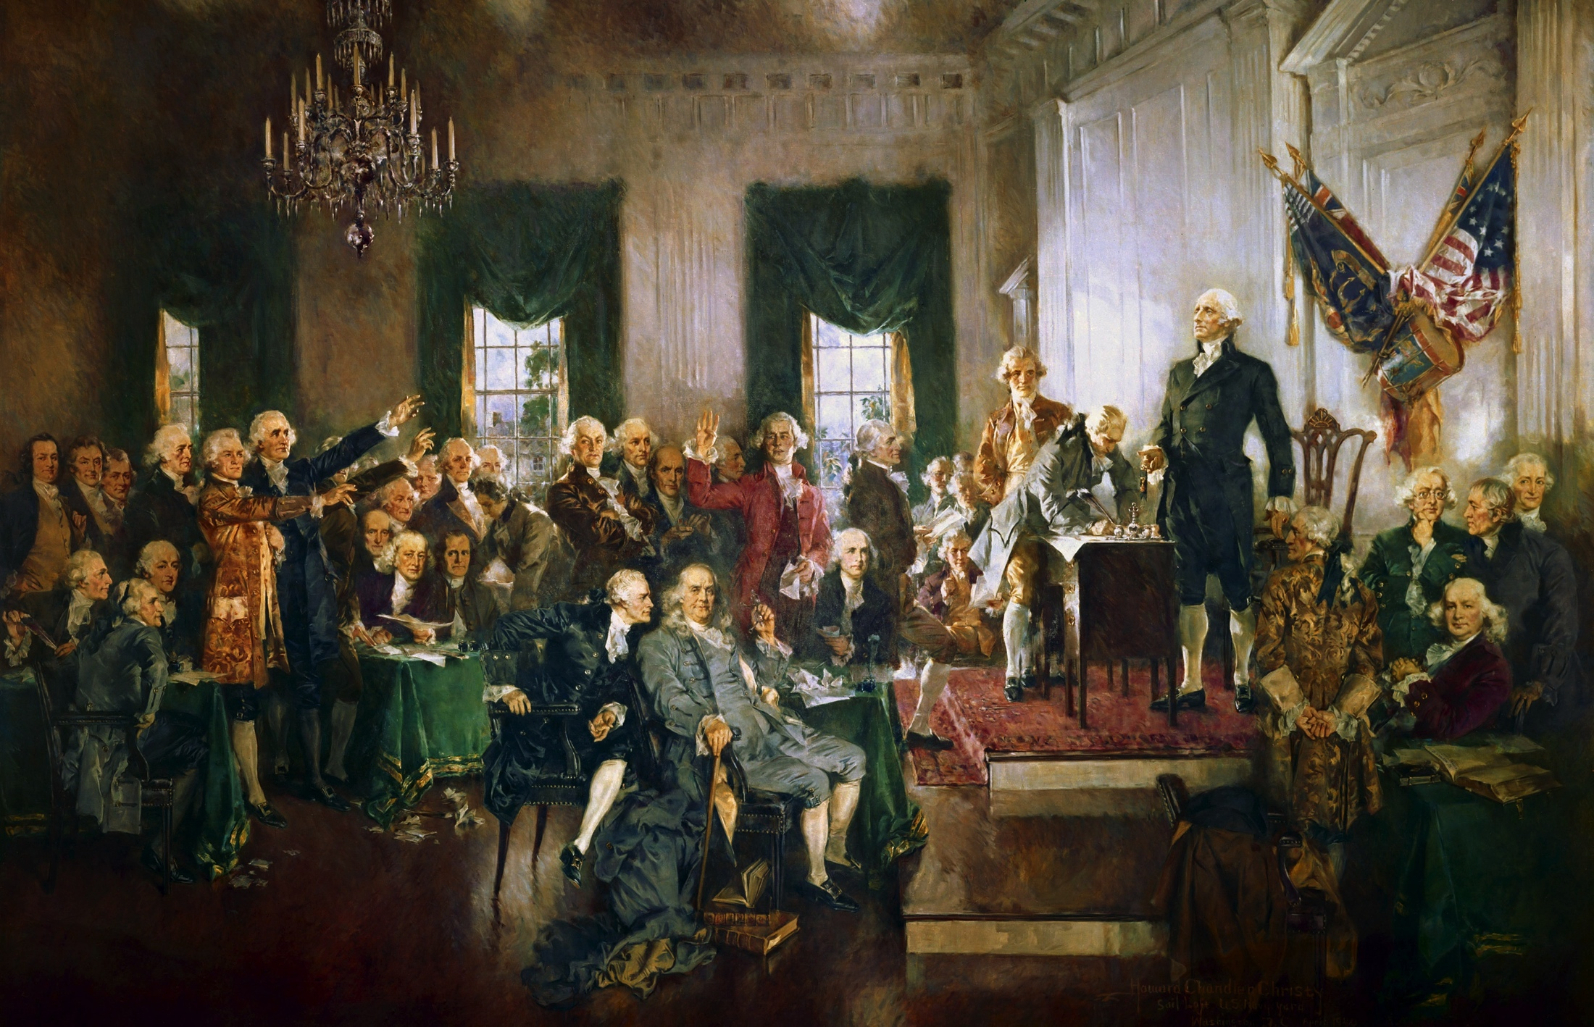
Creation of the U.S. Constitution
Philadelphia Convention (February 21, 1787)
Notes:
On the appointed day, May 14, 1787, only the Virginia and Pennsylvania delegations were present. A quorum of seven states met and deliberations began on May 25. Eventually twelve states were represented; 74 delegates were named, 55 attended and 39 signed.

Slide 4
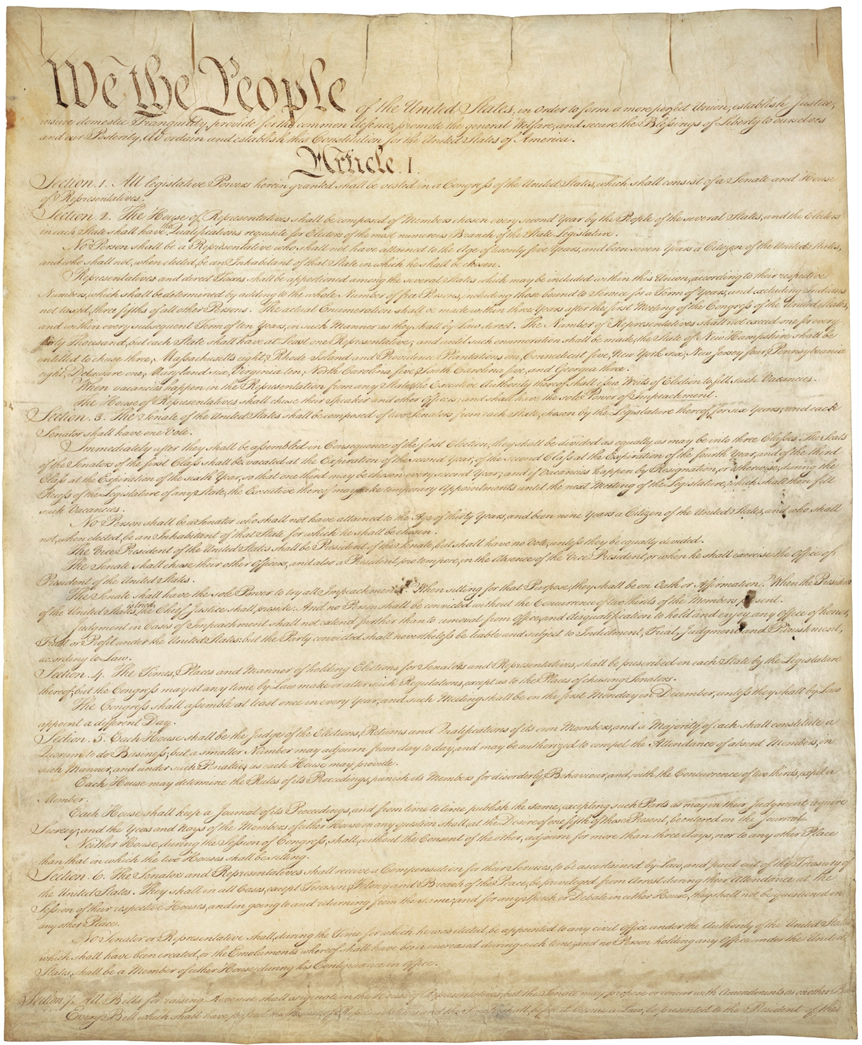
Creation of the U.S. Constitution
Four months of debate - September 8, 1787, the final text of the Constitution was set down and revised
September 17, 1787, 39 delegates endorsed and submitted the Constitution to the Congress of the Confederation
By the end of July 1788, eleven states had ratified the Constitution. North Carolina and Rhode Island ratified by May 1790.
Notes:
Federalist Papers: Alexander Hamilton, James Madison, and John Jay promoting the ratification of the United States Constitution.
The Virginia Plan recommended a consolidated national government, generally favoring the most populated states. It used the philosophy of John Locke to rely on consent of the governed, Montesquieu for divided government, and Edward Coke to emphasize civil liberties. The New Jersey Plan generally favored the less populated states, using the philosophy of English Whigs such as Edmund Burke to rely on received procedure, and William Blackstone to emphasize sovereignty of the legislature.

Slide 5
Framework of U.S. Constitution
Seven articles and 27 amendments – shortest written constitution in force
Articles 1, 2 & 3: Separate of Powers
Articles 4, 5 & 6: Federalism
Article 7: Ratification
Amendments:
1 – 10: Bill of Rights
Other Amendments

Slide 6
Marbury v. Madison (1803)
“The most important case in U.S. constitutional law history.”

Slide 7
John Marshall
4th Chief Justice of the Supreme Court
In office: January 31, 1801 – July 6, 1835
“The Great Chief Justice”
Notes:
Marshall a brilliant judge, but an even more brilliant political strategist.
The Supreme Court in 1803 wasn’t anybody’s idea of an equal branch of government.
But no one saw it this way in 1803. When justices retired in 1790s, Washington had hard time finding replacements – mostly b/c they spent most of year riding circuit, sleeping in drafty taverns, sharing bed with strangers.
John Jay, first Chief Justice, left court to run for governor of NY. When Adams tried to reappoint him C Just in 1801, Jay refused – saying it’s a trivial institution.

Slide 8
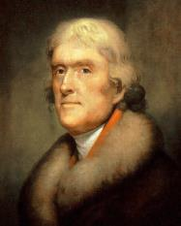
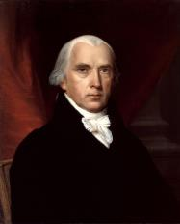
Federalist v. Democratic-Republican (Jeffersonian Republicans)
John Adams
Thomas Jefferson
John Marshall
James Madison

Slide 9
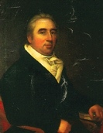
Marbury v. Madison (1803)
Judiciary Act of 1801
President to appoint Federal judges and justices of the peace
“Midnight Judges” (16 circuit judges and 42 justices of the peace – all Federalists)
William Marbury
Notes:
During this lame-duck session, Congress passed the Judiciary Act of 1801. This Act modified the Judiciary Act of 1789 in establishing ten new district courts, expanding the number of circuit courts from three to six, and adding additional judges to each circuit, giving the President the authority to appoint Federal judges and justices of the peace. The act also reduced the number of Supreme Court justices from six to five, effective upon the next vacancy in the Court.

Slide 10
Marbury v. Madison (1803)
Writ of Mandamus
Marshall’s dilemma
Marbury lost (0:5) – Marshall’s Opinion:
Has the applicant a right to the commission he demands?
If he has a right, and that right has been violated, do the laws of his country afford him a remedy?
If they do afford him a remedy, is it a mandamus issuing from this court?

Slide 11
Marbury v. Madison (1803)
Whether the Court has jurisdiction?
Marbury: Yes. §13 of the Judiciary Act of 1789:
The Supreme Court has the right “to issue writs of mandamus, in cases warranted by the principles and usages of law, to any courts appointed, or persons holding, office, under the authority of the United States.”
Marshall: Let’s read the Constitution:
In all Cases affecting Ambassadors, other public Ministers and Consuls, and those in which a State shall be Party, the supreme Court shall have original Jurisdiction. In all the other Cases before mentioned, the supreme Court shall have appellate Jurisdiction, both as to Law and Fact, with such Exceptions, and under such Regulations as the Congress shall make.

Slide 12
Marbury v. Madison (1803)
Takeaways
“an act of the legislature, repugnant to the constitution, is void”
“It is emphatically the province and duty of the judicial department to say what the law is.”
Constitution being higher than ordinary law – “a supreme paramount law, unchangeable by ordinary means”
Notes:
If no jurisdiction: why give an opinion?
Marshall should’ve excused himself

Slide 13
McCulloch v. Maryland (1819)
Implied powers of Congress

Slide 14
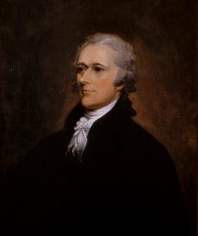
McCulloch v. Maryland (1819)
First Bank of the United States (1791 – 20 years)
Second Bank of the United States (1816)
Alexander Hamilton

Slide 15
McCulloch v. Maryland (1819)
Maryland imposed a tax on all banks, or branches thereof, in the State of Maryland, not chartered by its legislature.
Maryland: Congress has no right to charter a bank
Enumerated power (Congress) v. Inherent power (States)
The powers not delegated to the United States by the Constitution, nor prohibited by it to the States, are reserved to the States respectively, or to the people. (Amendment 10)

Slide 16
McCulloch v. Maryland (1819)
Maryland lost (0:7) – Marshall’s Opinion:
It was the people who ratified the Constitution and thus the people are sovereign, not the states.
The Constitution did not enumerate the power to create a bank, but “in considering this question, we must never forget, that it is a constitution we are expounding.”
Necessary and Proper Clause
Congress shall have power to “make all Laws which shall be necessary and proper for carrying into Execution the foregoing Powers…”

Slide 17
McCulloch v. Maryland (1819)
How to interpret “necessary?”
Maryland: absolutely essential.
Marshall: could mean “convenient” or… “useful”…
“Let the end be legitimate, let it be within the scope of the constitution, and all means which are appropriate, which are plainly adapted to that end, which are not prohibited, but consist with the letter and spirit of the constitution, are constitutional.”
Notes:
Marshall also noted that the Necessary and Proper Clause is listed within the powers of Congress, not the limitations.
Bank is conducive for these objectives as borrow money, to regulate commerce, to declare and conduct war. National government is entrusted with very important objects must be also entrusted with means are necessary to realize these objects.

Slide 18
McCulloch v. Maryland (1819)
Can Maryland tax the bank?
Maryland: you should trust us.
Marshall:
The power to create implies the power to preserve.
The power to destroy is incompatible to the power to preserve.
The supreme one must overrule the inferior.

Slide 19
Dred Scott v. Sandford (1857)
“Worst decision ever made by the U.S. Supreme Court.”
Notes:
The court misspelled Sanford's name in the decision.

Slide 20
Roger Taney
5th Chief Justice of the Supreme Court
In office: March 15, 1836 – October 12, 1864
Notes:
a slaveholder who manumitted his slaves
Taney died during the final months of the American Civil War on the same day that his home state of Maryland abolished slavery.

Slide 21
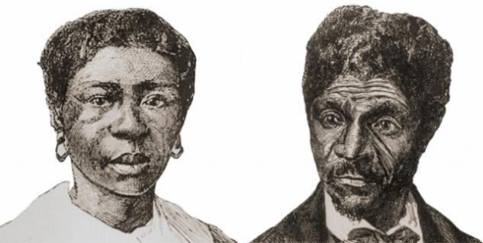
Dred and Harriet Scott
Born a slave in Virginia
Taken by owner to Missouri and sold to Dr. John Emerson
Travelled to Illinois (free state) and Wisconsin territory (part of later became the state of Minnesota – slavery was prohibited by Congress under the Missouri Compromise)
Went back to Missouri
Notes:
Illinois, a free state, had been free as a territory under the Northwest Ordinance of 1787, and had prohibited slavery in its constitution in 1819 when it was admitted as a state.

Slide 22
Dred Scott v. Sandford (1857)
Scott lost (2:7). Taney’s opinion:
Is a Free Black a Citizen? (Diversity Jurisdiction)
Taney: No. (Originalism argument)
Blacks are “beings of an inferior order, and altogether unfit to associate with the white race, either in social or political relations, and so far inferior that they had no rights which the white man was bound to respect.”
Therefore Scott could not bring suit in federal court under diversity of citizenship rules
Enumerated power: The provisions of the Missouri Compromise declaring it to be free territory were beyond Congress’s power to enact.
Individual rights: The Fifth Amendment barred any law that would deprive a slaveholder of his property, such as his slaves, upon the incidence of migration into free territory. (Substantive due process v. procedural due process)
Notes:
While Chief Justice Roger B. Taney had hoped to settle issues related to slavery and Congressional authority by this decision, it aroused public outrage and deepened sectional tensions between the northern and southern U.S. states. President Abraham Lincoln's Emancipation Proclamation in 1863, and the post-Civil War Thirteenth, Fourteenth and Fifteenth amendments nullified the decision.
Taney spent pages 407-421 of his decision chronicling the history of slave and negro law in the British colonies and American states. His goal was to ascertain whether, at the time the Constitution was ratified, federal law could have recognized Scott (a Negro descendant of a slave) as a citizen of any state within the meaning of Article III.
This was the second time in United States history that the Supreme Court had found an act of Congress to be unconstitutional. (The first time was 54 years earlier in Marbury v. Madison).
Nor, these justices argued, was there any basis for the claim that blacks could not be citizens. At the time of the ratification of the Constitution, black men could vote in five of the thirteen states. This made them citizens not only of their states but of the United States. Therefore, Justice McLean concluded that the argument that Scott was not a citizen was "more a matter of taste than of law". In his dissent, Justice McLean cited as precedent Marie Louise v. Marot, an 1835 case in which Louisiana Supreme Court Chief Justice George Mathews Jr. ruled that "being free for one moment in [territory non-permitting of slavery], it was not in the power of [a] former owner to reduce [a slave] again to slavery."

Slide 23
Amendments to the Constitution
13th Amendment (ending slavery) (1865)
14th Amendment (extending citizenship, guaranteeing equality, due process) (1868)
“All persons born or naturalized in the United States and subject to the jurisdiction thereof, are citizens of the United States and of the State wherein they reside….”
15th Amendment (right to vote) (1870)

Slide 24
Brown v. Board of Education (1954)
The beginning of desegregation

Slide 25
Brown v. Board of Education (1954)
Plessy v. Ferguson (1896) (7:1)
“Separate but equal” is not barred by 14th Amendment
Justice John Marshall Harlan’s dissent:
“[I]n view of the constitution, in the eye of the law, there is in this country no superior, dominant, ruling class of citizens. There is no caste here. Our constitution is color-blind, and neither knows nor tolerates classes among citizens. In respect of civil rights, all citizens are equal before the law. The humblest is the peer of the most powerful. The law regards man as man, and takes no account of his surroundings or of his color when his civil rights as guaranteed by the supreme law of the land are involved.”
BUT – antichinese: “There is a race so different from our own that we do not permit those belonging to it to become citizens of the United States. Persons belonging to it are, with few exceptions, absolutely excluded from our country. I allude to the Chinese race. But by the statute in question, a Chinaman can ride in the same passenger coach with white citizens of the United States, while citizens of the black race [cannot]....”
Notes:
“We consider the underlying fallacy of the plaintiff's argument to consist in the assumption that the enforced separation of the two races stamps the colored race with a badge of inferiority. If this be so, it is not by reason of anything found in the act, but solely because the colored race chooses to put that construction upon it.”

Slide 26
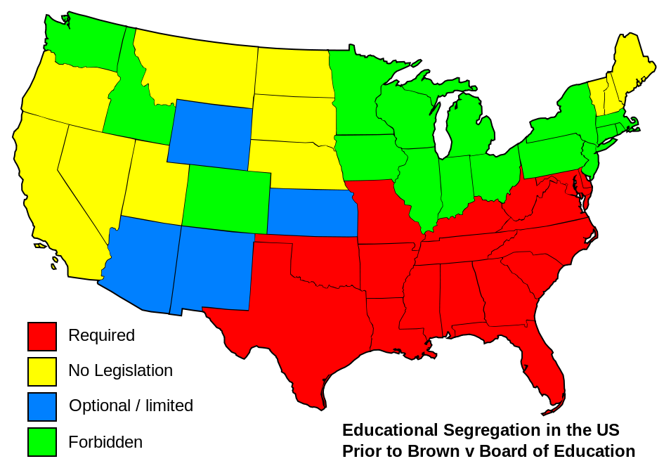

Slide 27
Brown v. Board of Education (1954)
Class action (13 parents) against Board of Education of the City of Topeka, Kansas
A 1879 Kansas law: permitted (but did not require) districts to maintain separate elementary school facilities for black and white students in twelve communities with populations over 15,000
Heard in spring 1953; re-heard in fall 1953 (seeking unanimity)
Notes:
The case was being reargued at the behest of Associate Justice Felix Frankfurter, who used reargument as a stalling tactic, to allow the Court to gather a unanimous consensus around a Brown opinion that would outlaw segregation. Chief Justice Vinson had been a key stumbling block. The justices in support of desegregation spent much effort convincing those who initially intended to dissent to join a unanimous opinion.

Slide 28
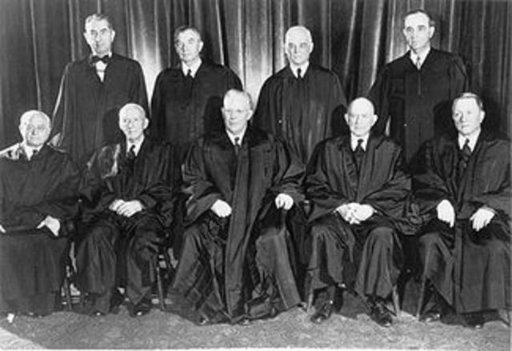
On May 17, 1954, these men, members of the U.S. Supreme Court, ruled unanimously that racial segregation in public schools is unconstitutional.

Slide 29
Brown v. Board of Education (1954)
Unanimous decision:
Even if segregated black and white schools were of equal quality in facilities and teachers, segregation by itself was harmful to black students and unconstitutional (significant psychological and social disadvantage).
“We conclude that, in the field of public education, the doctrine of “separate but equal” has no place. Separate educational facilities are inherently unequal. Therefore, we hold that the plaintiffs and others similarly situated for whom the actions have been brought are, by reason of the segregation complained of, deprived of the equal protection of the laws guaranteed by the Fourteenth Amendment.”
Notes:
The case was being reargued at the behest of Associate Justice Felix Frankfurter, who used reargument as a stalling tactic, to allow the Court to gather a unanimous consensus around a Brown opinion that would outlaw segregation. Chief Justice Vinson had been a key stumbling block. The justices in support of desegregation spent much effort convincing those who initially intended to dissent to join a unanimous opinion.
Chief Justice Vinson had been a key stumbling block. After Vinson died in September 1953, President Dwight D. Eisenhower appointed Earl Warren as Chief Justice.

Slide 30
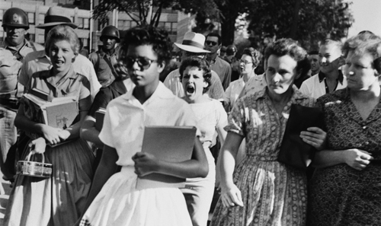
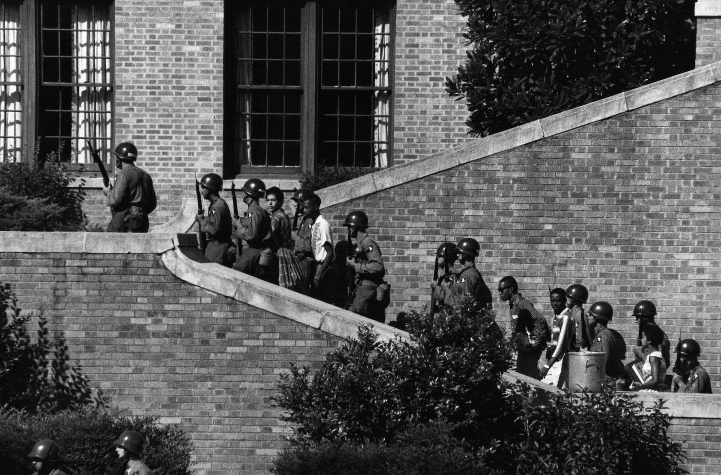
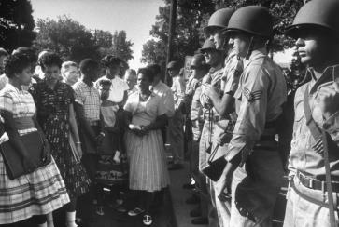
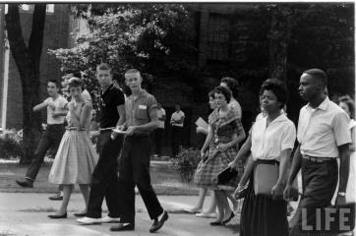
Little Rock Nine (Arkansas, 1957)
Notes:
Little Rock Nine were a group of African American students enrolled in Little Rock Central High School in 1957. Their enrollment was followed by the Little Rock Crisis, in which the students were initially prevented from entering the racially segregated school by Orval Faubus, the Governor of Arkansas. They then attended after the intervention of President Dwight D. Eisenhower.

Slide 31
United States v. Nixon (1974)
Is there a limit on the President’s power?

Slide 32
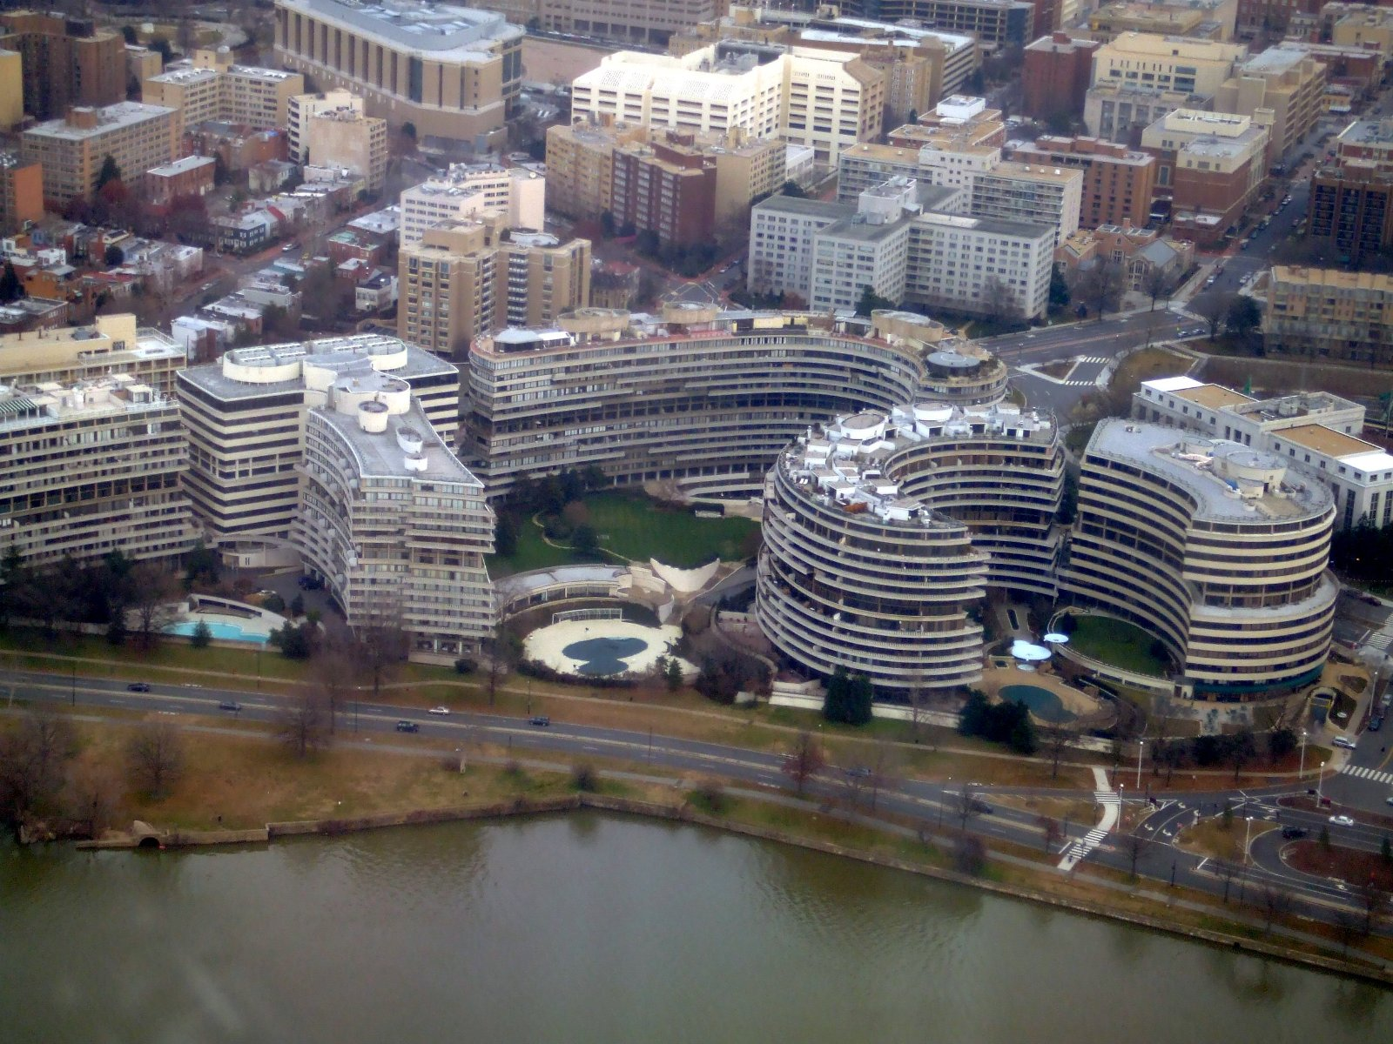
United States v. Nixon (1974)
Watergate Scandal

Slide 33
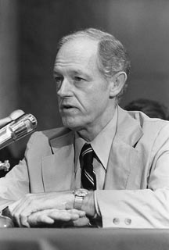
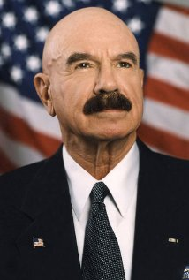
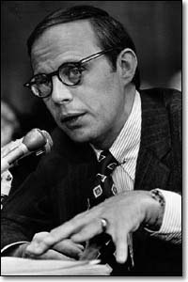
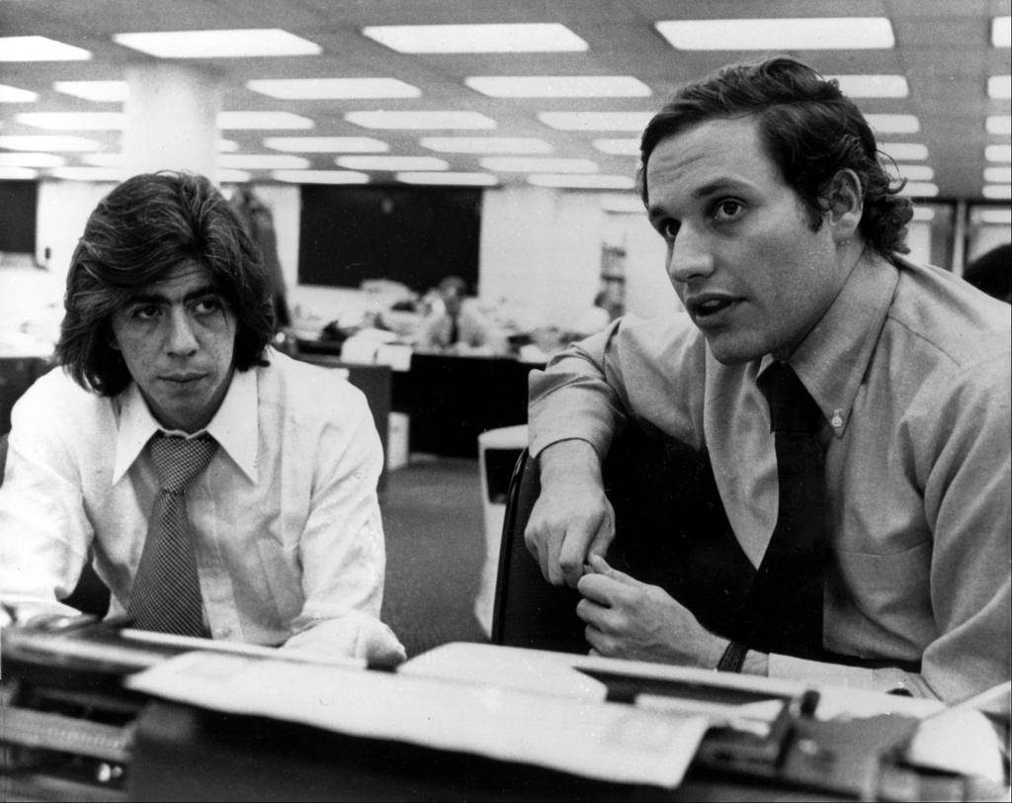
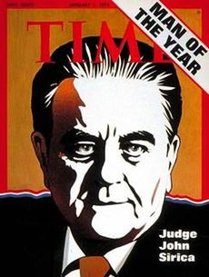
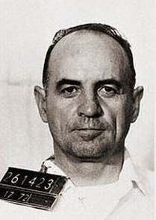
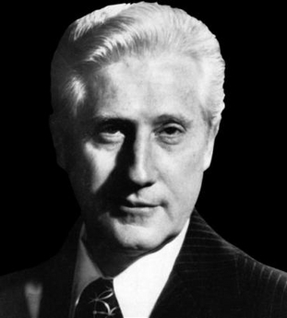
United States v. Nixon (1974)
E. Howard Hunt
Security Consultant
G. Gordon Liddy
GC to the Committee for the Re-Election of the President
John Wesley Dean
White House Counsel
Carl Bernstein and Bob Woodward
Journalists at the Washington Post
James W. McCord
Electronics Expert
Mark Felt
FBI Associate Director
Judge John Sirica
Chief Judge for DC District
Notes:
The Watergate scandal resulted in 69 government officials being charged and 48 being found guilty.

Slide 34
United States v. Nixon (1974)
Watergate Scandal
Break-in at the Democratic National Committee (DNC) headquarters at the Watergate office complex in Washington, D.C. (06/17/1972)
Nixon’s cover-up. However, has tapes.
Elliot Richardson, Nixon’s AG, appointed Archibald Cox to the position of special prosecutor to investigate (05/1973)
Cox asked for tapes. Nixon refused. Then compromise – Stennis Compromise (had hearing problems)
“Saturday Night Massacre” (10/20/1973)
Cox fired (by Robert Bork). Richardson and Deputy Attorney General William Ruckelshaus resigned.

Slide 35
United States v. Nixon (1974)
New special prosecutor, Leon Jaworski, appointed.
Jaworski obtained a subpoena ordering Nixon to release certain tapes and papers related to specific meetings between the President and those indicted by the grand jury (a separate case).
Nixon turned over edited transcripts of 43 conversations and asked U.S. District Court for the District of Columbia to quash the subpoena – denied by court.
Appealed to the Supreme Court

Slide 36
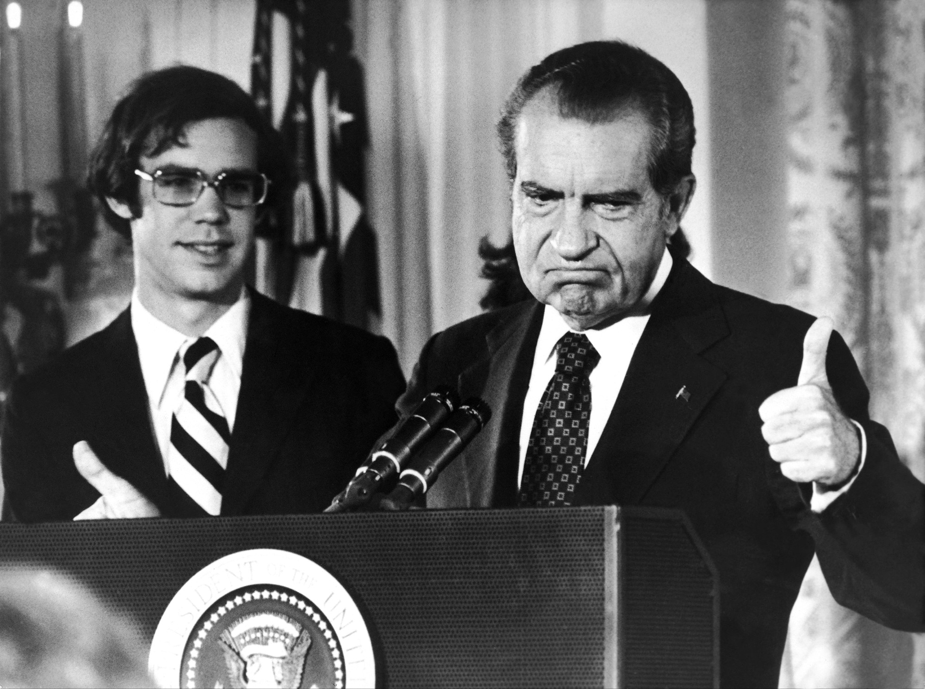
United States v. Nixon (1974)
Nixon:
No judicial review of this whatsoever; OR
Absolute executive privilege to protect communications between "high Government officials and those who advise and assist them in carrying out their duties.”
Nixon lost (0:8) (Justice Rehnquist recused, 3 of the 8 were Nixon appointees)
There is executive privilege, BUT not absolute.
Trial court balancing – balance done by the District Court in camera
Nixon released the tapes, resigned 15 days later.
Notes:
text says nothing. Ct is being asked to answer the Q based on inferences from some text in Art II and elsewhere: II.1.1.: “the executive power shall be vested in a President of the USA”. p. il: II § 3: “he, the President, shall take care that the laws be faithfully executed”
How much does the larger political setting (the level of popularity of the president) matter to how we interpret the law that NIXON establishes?

Slide 37
Miranda v. Arizona (1966)
You have the right to remain silent

Slide 38
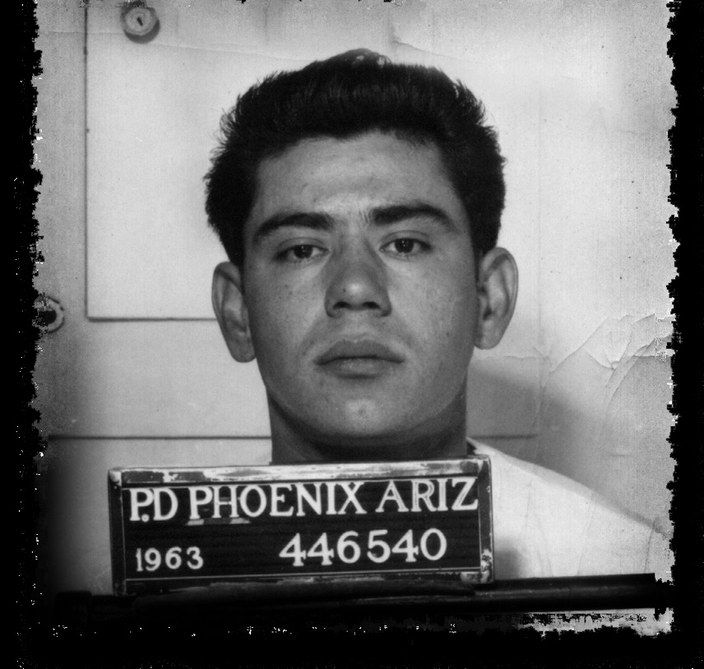
Miranda v. Arizona (1966)
March 13, 1963: Ernesto Miranda arrested by the Phoenix Police Department based on circumstantial evidence linking him to the kidnapping and rape of an 15-year-old girl ten days earlier.
After two hours of interrogation, he signed a confession to the rape charge on forms provided by the police.
He was not told his right to counsel, to remain silent, or anything he said could be used against him on court.
On trail he was convicted of rape and kidnapping and sentenced to 20 to 30 years imprisonment on each charge. The Arizona Supreme Court affirmed.

Slide 39
Miranda v. Arizona (1966)
5th Amendment: “No person shall be… compelled in any criminal case to be a witness against himself…”
6th Amendment: “In all criminal prosecutions, the accused shall enjoy the right to… have the Assistance of Counsel for his defence.”
Miranda won (5:4). Earl Warren’s opinion:
Coercive nature of the custodial interrogation by police
No confession could be admissible under the Fifth Amendment self-incrimination clause and Sixth Amendment right to an attorney unless a suspect had been made aware of his rights and the suspect had then waived them.

Slide 40
Miranda v. Arizona (1966)

Slide 41
Miranda v. Arizona (1966)

Slide 42
Miranda v. Arizona (1966)
Miranda
Retried and convicted in 1967 to serve 20 to 30 years
Paroled in 1972
Stabbed to death during an argument in a bar on January 31, 1976.
A suspect was found who (ironically) invoked his Miranda Rights and remained silent. Later released with no evidence.
Later cases established some exceptions (spontaneous statement; "public safety" exception)
Notes:
After his release, he returned to his old neighborhood and made a modest living autographing police officers' "Miranda cards" which contained the text of the warning, for reading to arrestees.
A number of empirical studies by both supporters and opponents of Miranda have concluded that the giving of Miranda warnings has little effect on whether a suspect agrees to speak to the police without an attorney.

Slide 43
Roe v. Wade (1973)
Pro-choice v. pro-life

Slide 44
Roe v. Wade (1973)
June 1969, Norma L. McCorvey discovered she was pregnant with her third child.
A 1854 Texas law prohibits abortion, other than for protecting mother’s health or in cases of rape and incest
In 1970, filed suit in a U.S. District Court in Texas on behalf of McCorvey (under the alias Jane Roe).
Prior case: Griswold v. Connecticut (1965)
Right to privacy

Slide 45
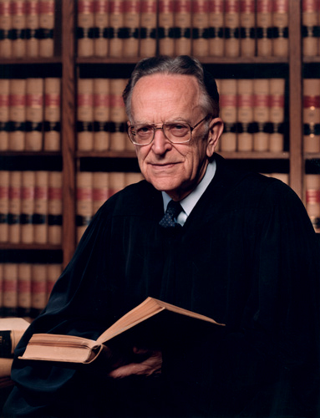
Roe v. Wade (1973)
Roe won (7:2). Just Blackmun’s opinion:
Right of privacy is broad enough to encompass a woman's decision whether or not to terminate her pregnancy.
Two important interests of government:
Protecting the mother's health
Protecting the "potentiality of human life”
Trimester framework
1st trimester: no regulation allowed
2nd trimester: regulating abortion for women’s health is allowed
3rd trimester: can regulate to protect life of the fetus
Notes:
The Court later rejected Roe's trimester framework, while affirming Roe's central holding that a person has a right to abortion until viability.
Perhaps the most important case after Brown.

Slide 46
Roe v. Wade (1973)
Norma McCorvey became a member of the pro-life movement in 1995; she now supports making abortion illegal.
Wade: now pro-choice.
Subsequent cases:
Webster v. Reproductive Health Services (1989) (upheld several abortion restrictions, and modified the Roe trimester framework.)
Planned Parenthood v. Casey (1992) (reaffirmed the central holding of Roe)

Slide 47
The Roberts Court (2010)
Notes:
Back row (left to right): Sonia Sotomayor, Stephen G. Breyer, Samuel A. Alito, and Elena Kagan. Front row (left to right): Clarence Thomas, Antonin Scalia, Chief Justice John G. Roberts, Anthony Kennedy, and Ruth Bader Ginsburg

