Slide 1
American isolationism
History, Present and Myths

Slide 2
Disclaimer
今天主要谈历史，现实部分只会在最后涉及
强调孤立主义的危险，不代表支持干涉主义
有些细节，如美国外交背后的现实主义、理想主义等等，限于时间原因无法深入

Slide 3
什么是孤立主义？（读者看法）
着重发展单边外交关系，不同与同本国有历史仇恨历史遗留问题的国家进行建交。
以下答案来自维基百科：孤立主义外交通常是由防务和经济上的两方面政策组成。在防务上，孤立主义采取不干涉原则，即除自卫战争外不主动卷入任何外部军事冲突；在经济文化上，通过立法最大程度限制与国外的贸易和文化交流。
不干涉 不主动卷入外交冲突 不热心对外贸易
美国只管自己的事情不参与国际政治事务
美国建国时百废待兴，为了避免参与欧洲搅屎而建立的“跟我没关系”外交传统。

Slide 4
殖民地时期
Charter of 1606 (Virginia)
JAMES, by the Grace of God, King of England, Scotland, France and Ireland, Defender of the Faith, &c. WHEREAS our loving and well-disposed Subjects, Sir Thorn as Gales, and Sir George Somers, Knights, Richard Hackluit, Clerk, Prebendary of Westminster, and Edward-Maria Wingfield, Thomas Hanharm and Ralegh Gilbert, Esqrs. William Parker, and George Popham, Gentlemen, and divers others of our loving Subjects, have been humble Suitors unto us, that We would vouchsafe unto them our Licence, to make Habitation, Plantation, and to deduce a colony of sundry of our People into that part of America commonly called VIRGINIA, and other parts and Territories in America, either appertaining unto us, or which are not now actually possessed by any Christian Prince or People, situate, lying, and being all along the Sea Coasts, between four and thirty Degrees of Northerly Latitude from the Equinoctial Line, and five and forty Degrees of the same Latitude, and in the main Land between the same four and thirty and five and forty Degrees, and the Islands "hereunto adjacent, or within one hundred Miles of the Coast thereof;

Slide 5
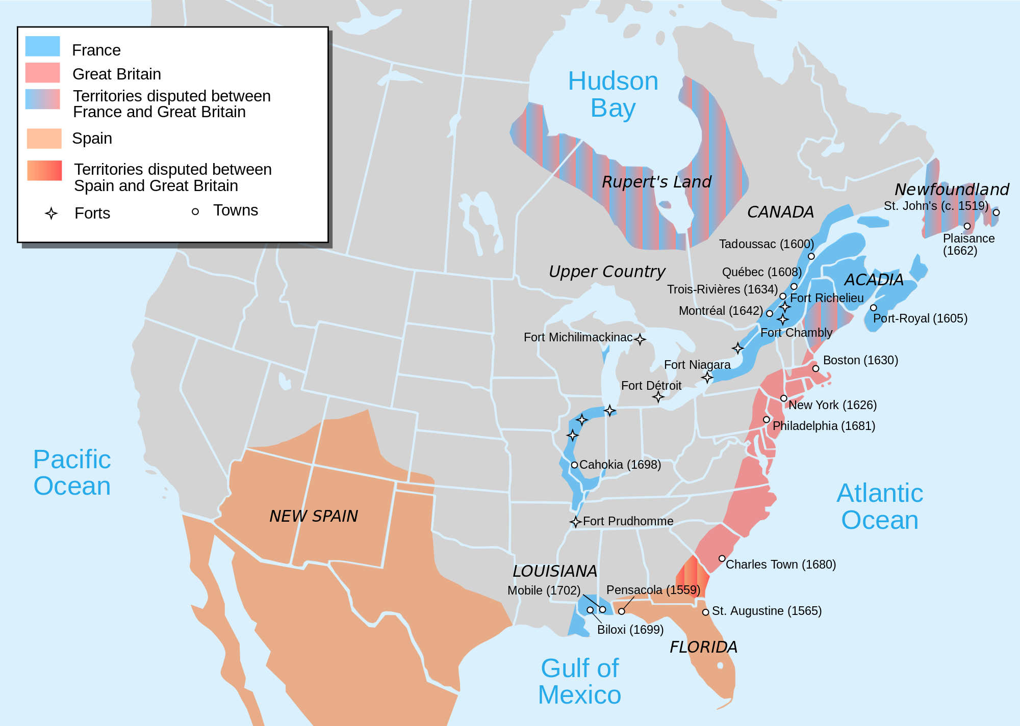
欧洲列强北美殖民地

Slide 6
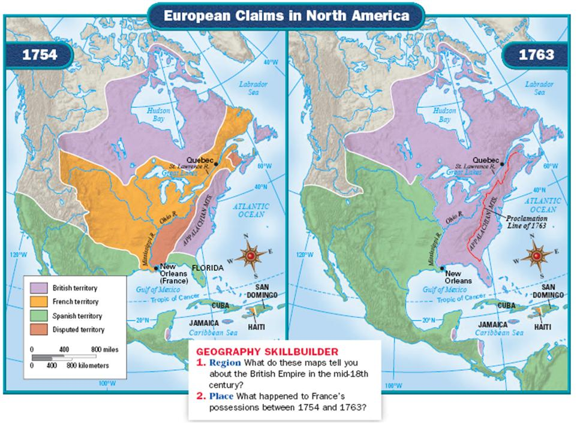
英法七年战争前后北美版图

Slide 7
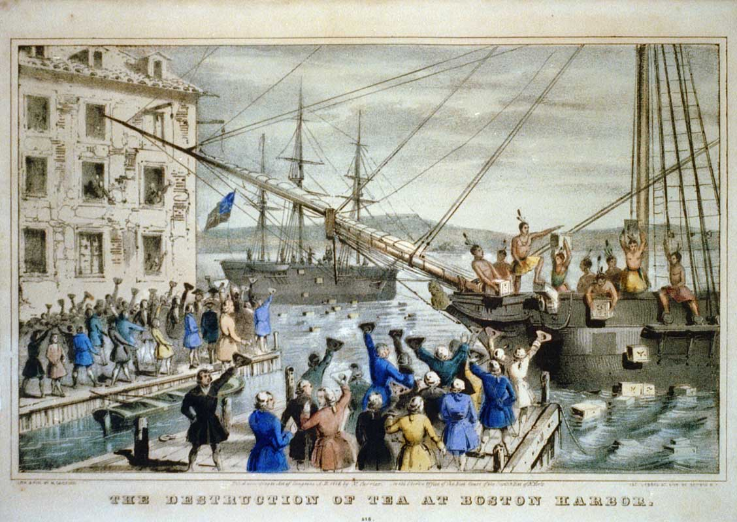
波士顿倾茶事件

Slide 8
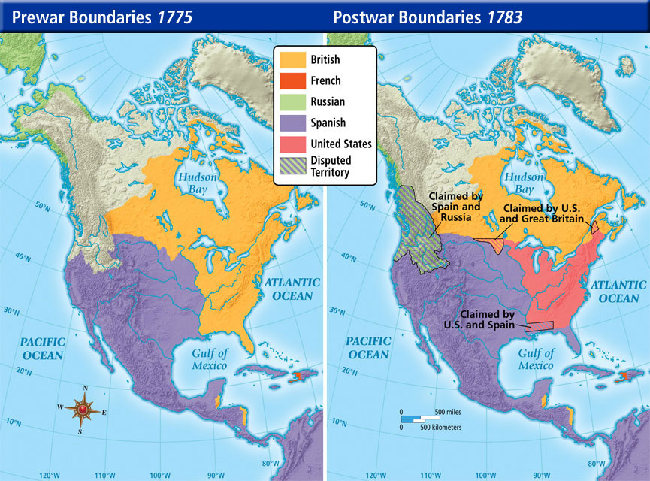
美国独立战争前后北美版图

Slide 9
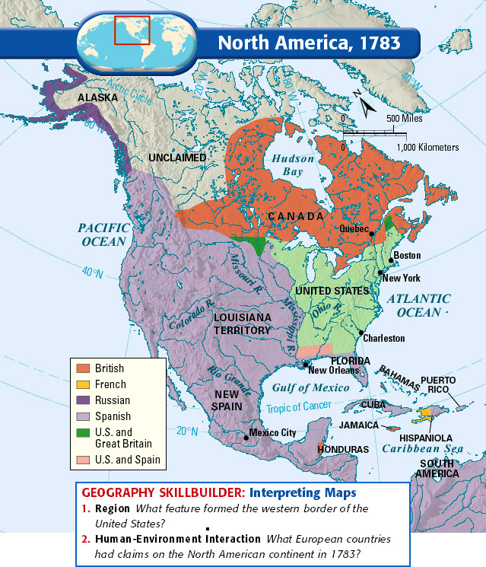
美国独立后地缘环境

Slide 10
美国中立宣言前内阁辩论

Slide 11
华盛顿退位演说
The great rule of conduct for us in regard to foreign nations is in extending our commercial relations, to have with them as little political connection as possible. So far as we have already formed engagements, let them be fulfilled with perfect good faith. Here let us stop.
Europe has a set of primary interests which to us have none; or a very remote relation. Hence she must be engaged in frequent controversies, the causes of which are essentially foreign to our concerns. Hence, therefore, it must be unwise in us to implicate ourselves by artificial ties in the ordinary vicissitudes of her politics, or the ordinary combinations and collisions of her friendships or enmities……
Taking care always to keep ourselves by suitable establishments on a respectable defensive posture, we may safely trust to temporary alliances for extraordinary emergencies.

Slide 12
亚当斯
在大陆会议中敦促”enter only into treaties of commerce, and to lay it down, as a first principle and a maxim never to be forgotten, to maintain an entire neutrality in all future European wars.”
Americans, aquatic as the tortoises and sea-fowl, would never be content to stay at home economically.
In 1784, to Elbridge Gerry, the United States shared North America with two hostile European neighbors, while several other had holdings in the West Indies, so America was bound to “have commercial connections with near all of” these countries, and that “commercial connections will involve us in perpetual disputes and frequent wars if we do not keep up our part.”

Slide 13
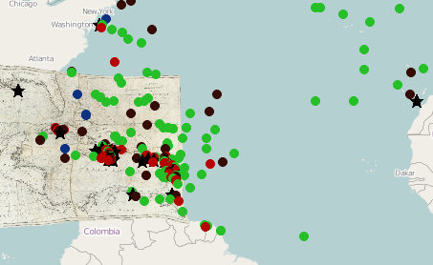
美法准战争
海上冲突图

Slide 14
杰斐逊
就职演说中：” peace, commerce and honest friendship with all nations, entangling alliances with none.”
但实际上，在私人信件中，他给和平列了很多条件：
1806年给杰克逊中他说“任何时候敌意的侵犯让我们不得不付诸于战争，我们将让全世界知道我们既是正直的朋友也是可怕的敌人。”
1811年一封信上说“如果和平变得比战争更丢人，那我们将选择后者。”
“容忍侮辱并不是躲避战争的方法”
“在任何情况下，战争都比任何形式向任何人进贡要强”
“绝对不付赎金。”
“如果现在【英国】这个提案会让我们介入战争，那么这将不能是它的战争，而应当是我们的战争……如果我们能够成功的分裂欧洲列强，把他们中间最强大的一员拉到我们的身边，我们当然应该这么做！”

Slide 15
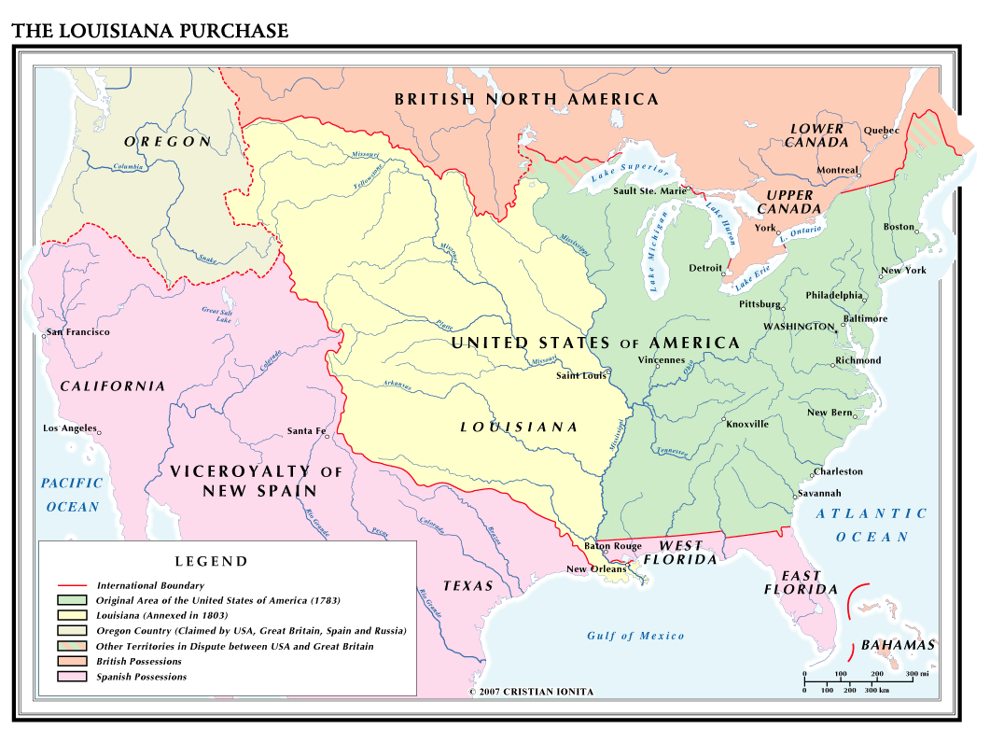
路易斯安那
殖民地购买

Slide 16
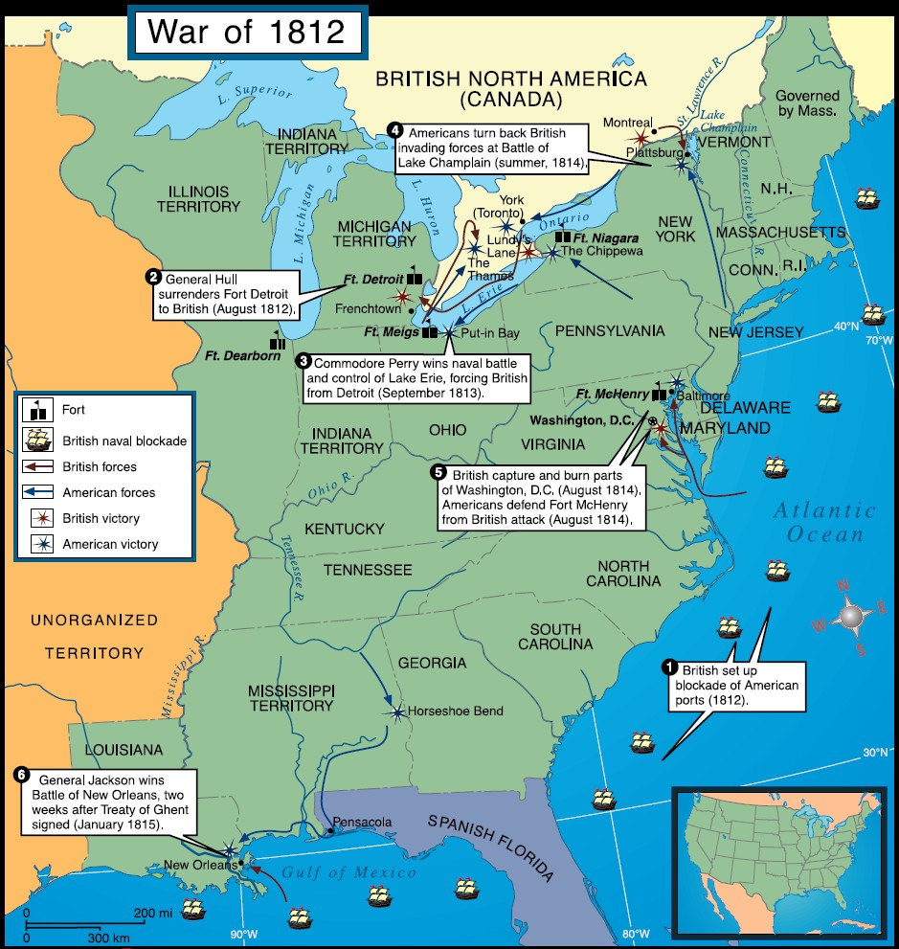
1812年
第二次英美战争

Slide 17
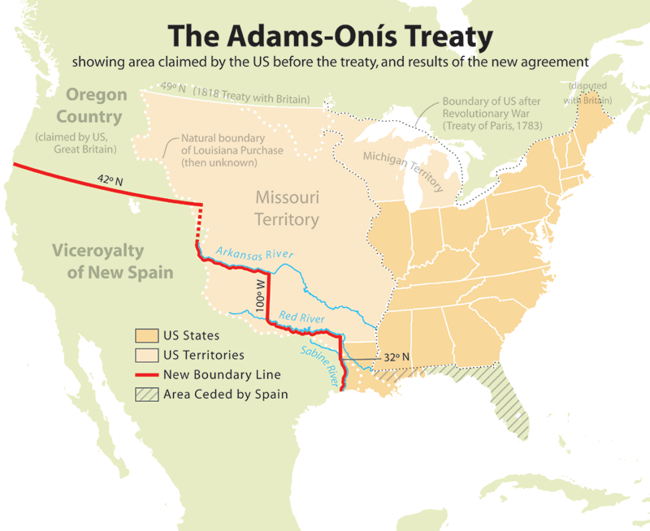
美国从西班牙兼并佛罗里达

Slide 18
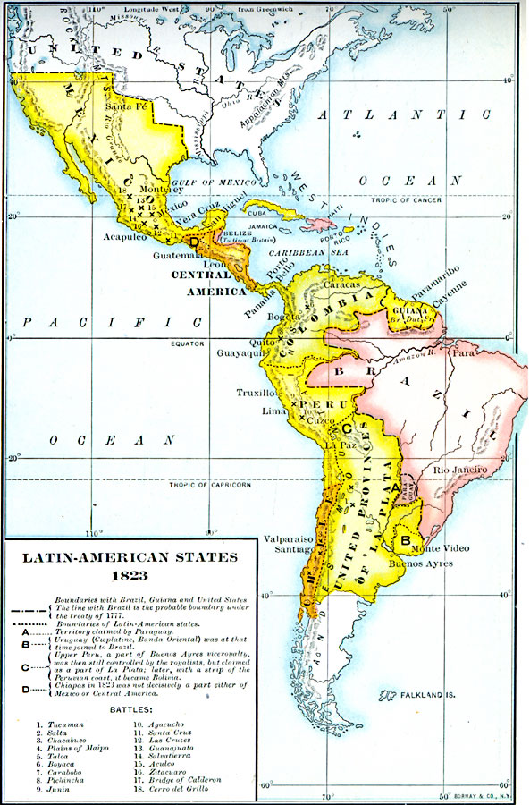
门罗宣言前
美洲局势

Slide 19
波士顿倾茶事件

Slide 20
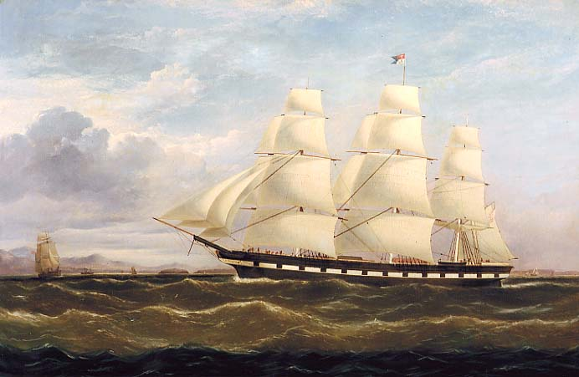
中国皇后号

Slide 21
扩张主义亚洲版 (Meet Opium traders)
JOHN JACOB ASTOR
皮草贸易的千万富翁
Stephen Girard
按GDP计算美国史最富四人之一

Slide 22
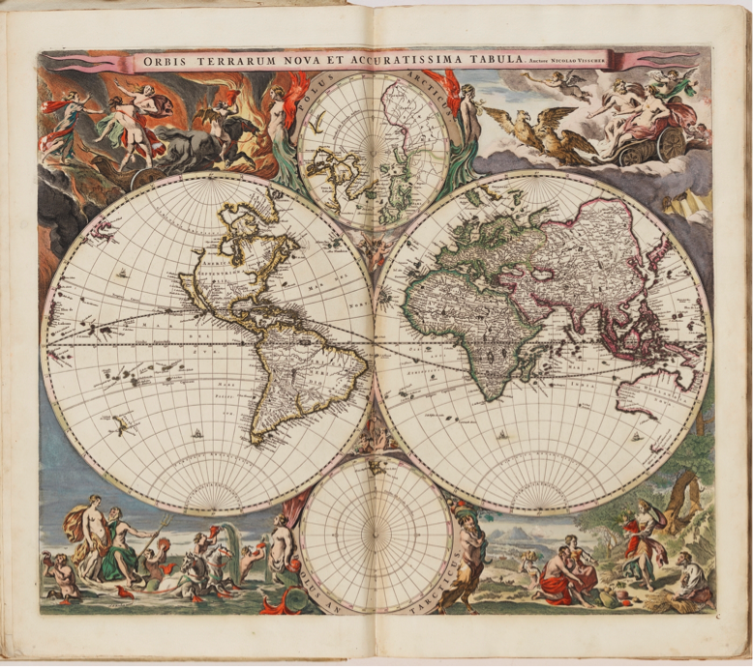

Slide 23
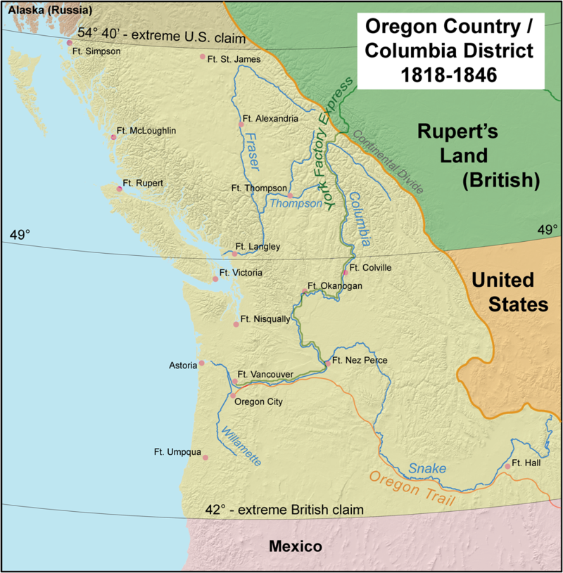
俄勒冈领地
争端和分割

Slide 24
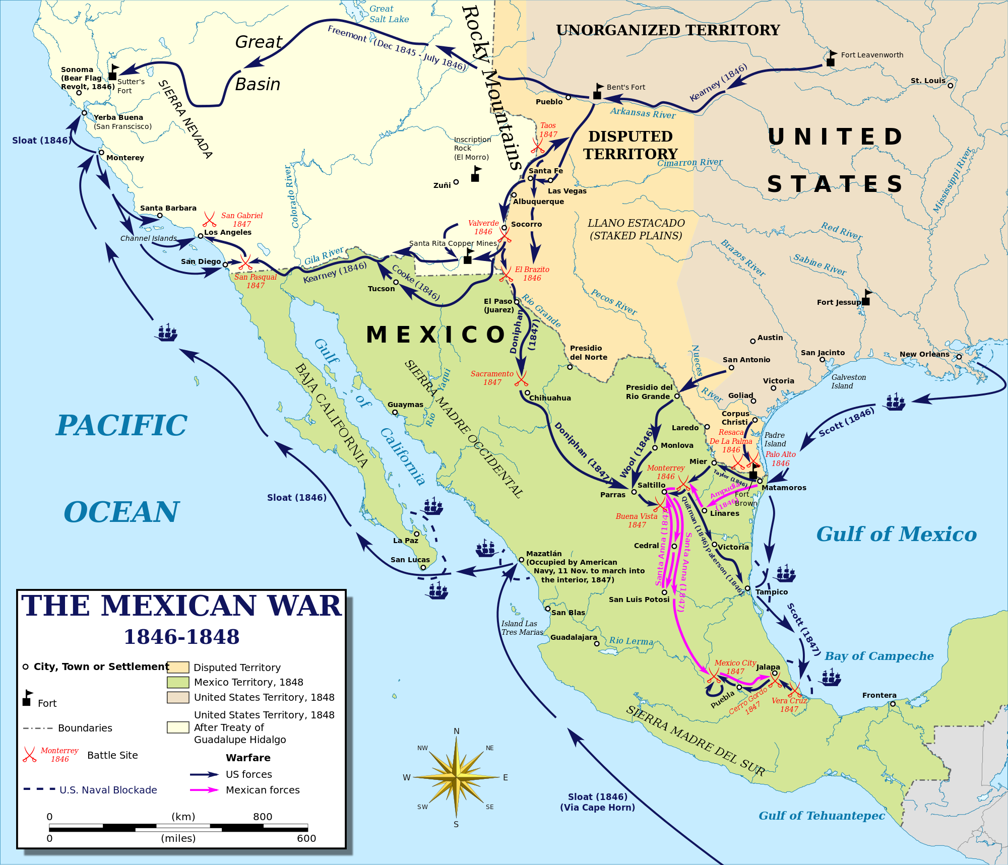
美墨战争

Slide 25
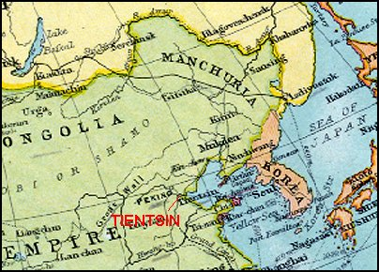
中国：
望厦条约
天津条约

Slide 26
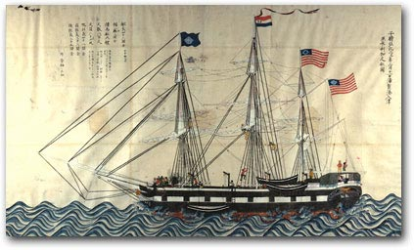
黑船事件：
佩里强迫日本开门

Slide 27
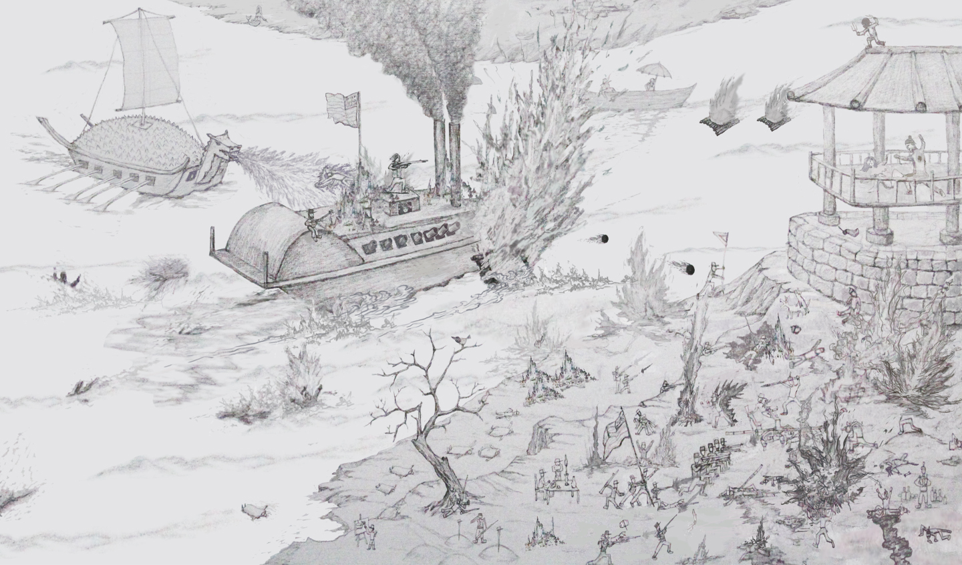
朝鲜： 舍门将军号事件

Slide 28
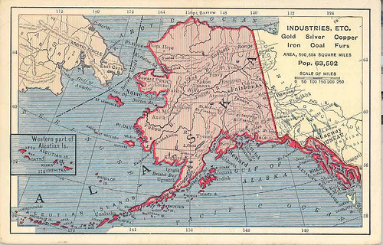
美国并购俄属阿拉斯加

Slide 29
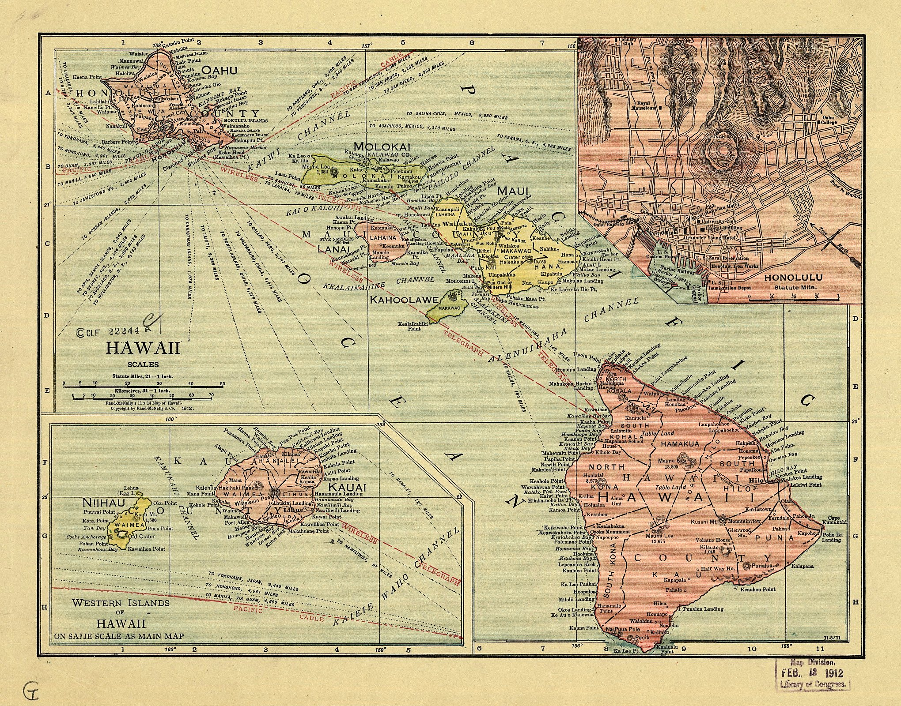
美国幕后颠覆夏威夷王国

Slide 30
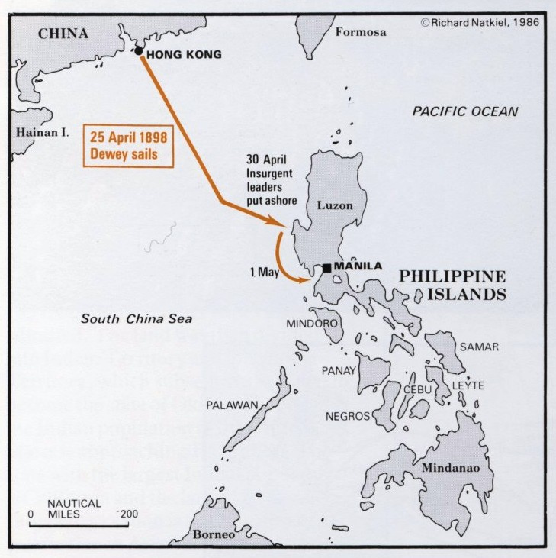
美西战争
亚洲战场

Slide 31
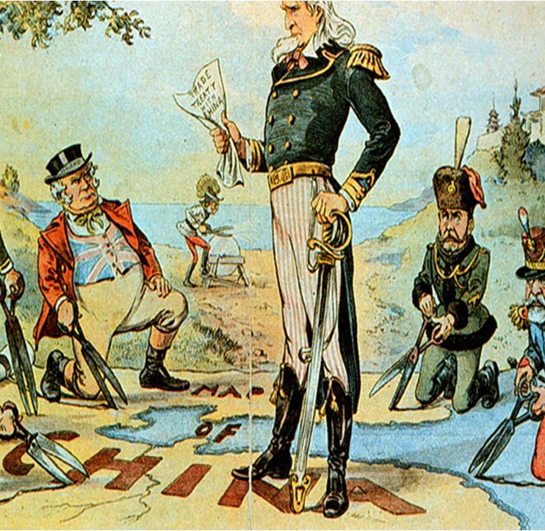
中国：
门户开放

Slide 32
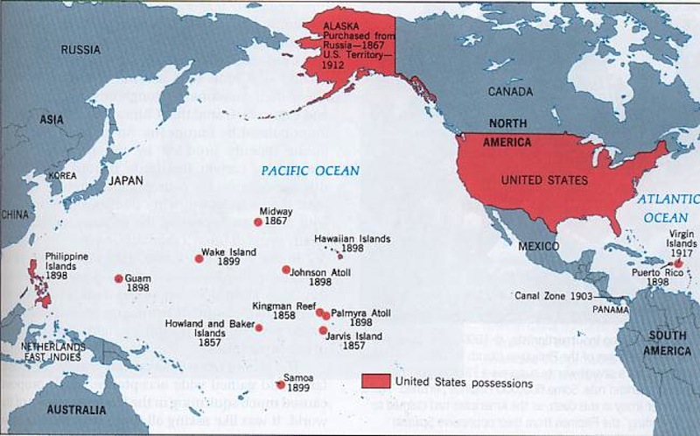
太平洋帝国

Slide 33
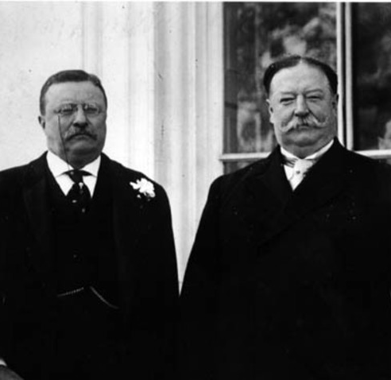
20世纪第一阶段
扩张期

Slide 34
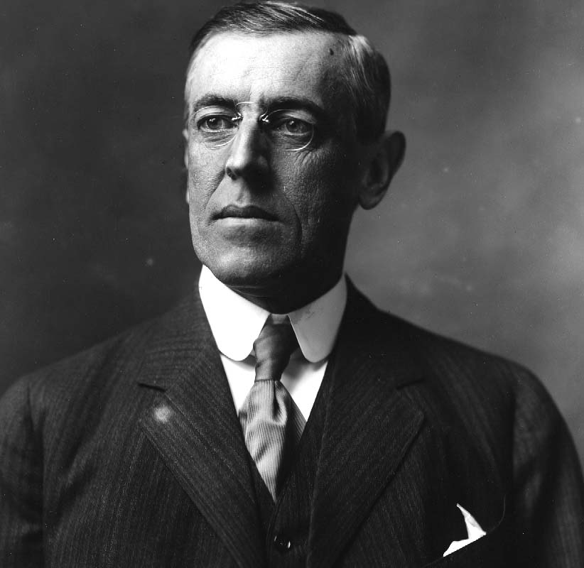
20世纪第一阶段
扩张期

Slide 35
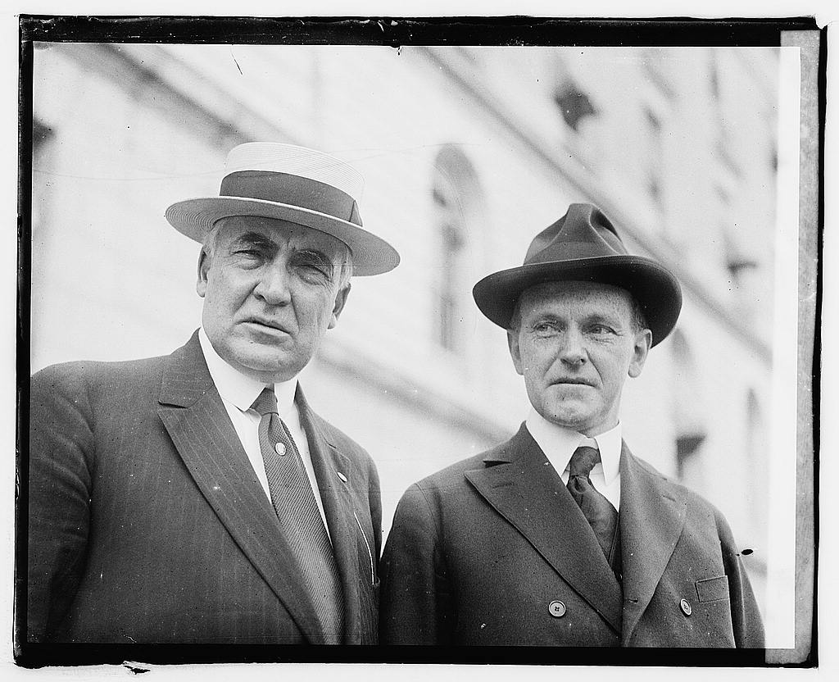
20世纪第一阶段
收缩期

Slide 36
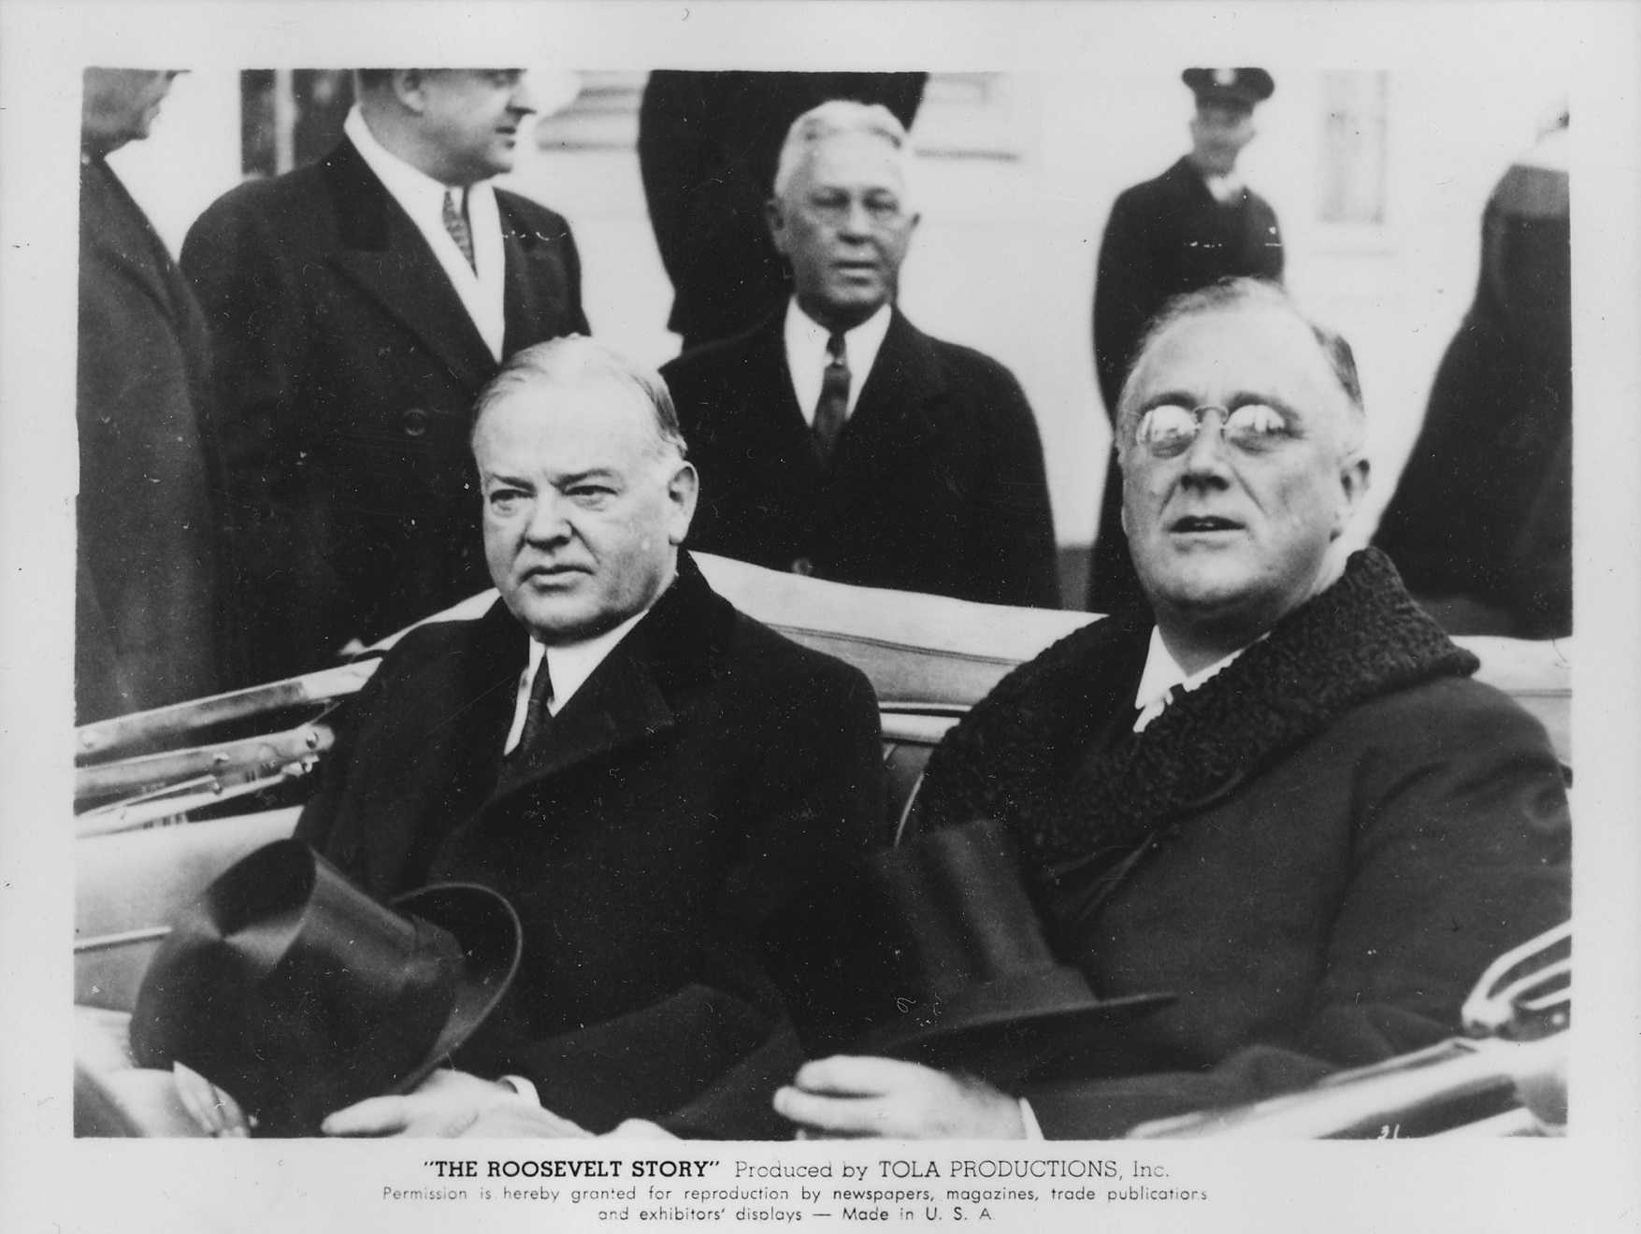
20世纪第一阶段
收缩期

Slide 37
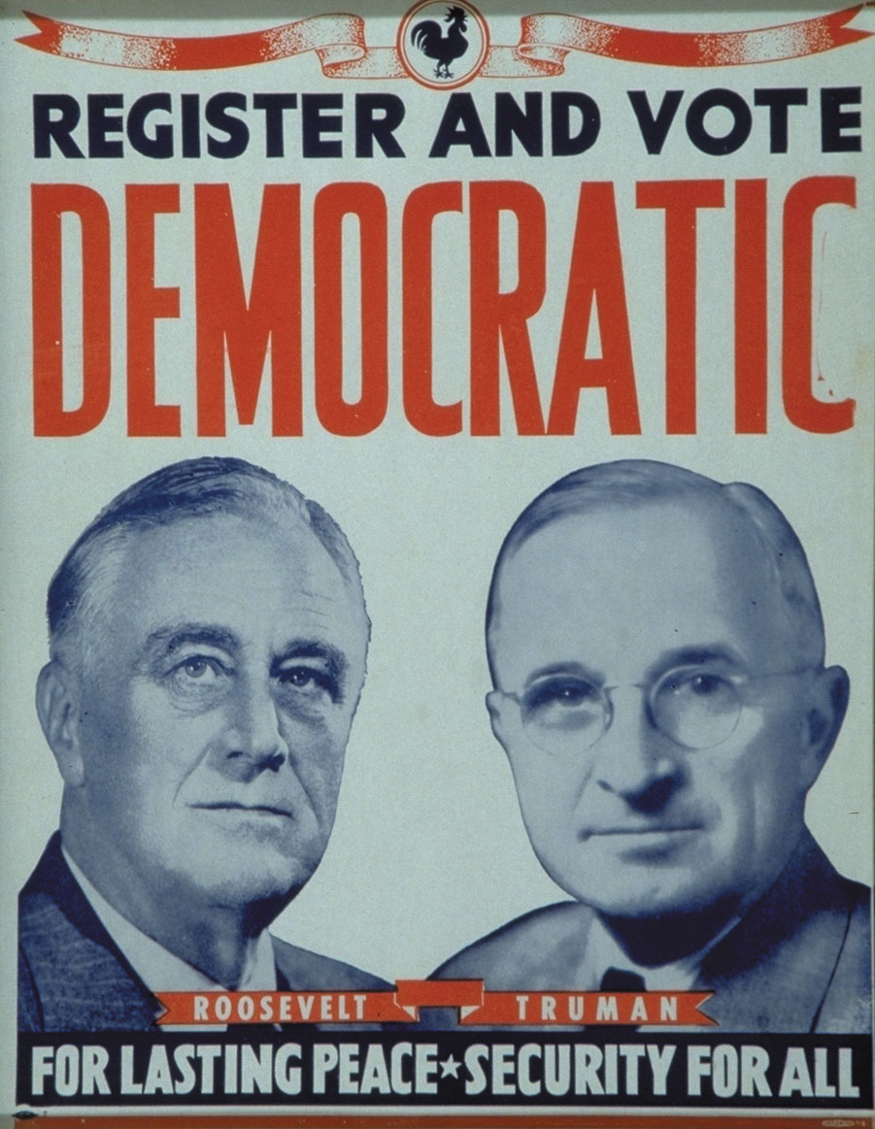
20世纪第二阶段
扩张期

Slide 38
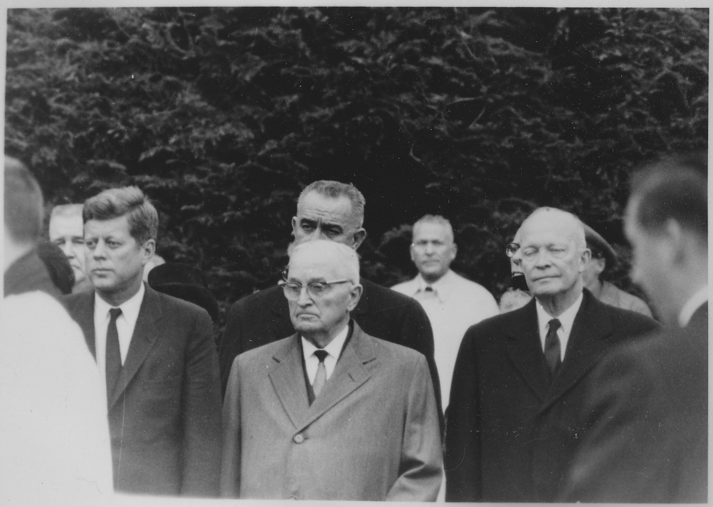
20世纪第二阶段
扩张期

Slide 39
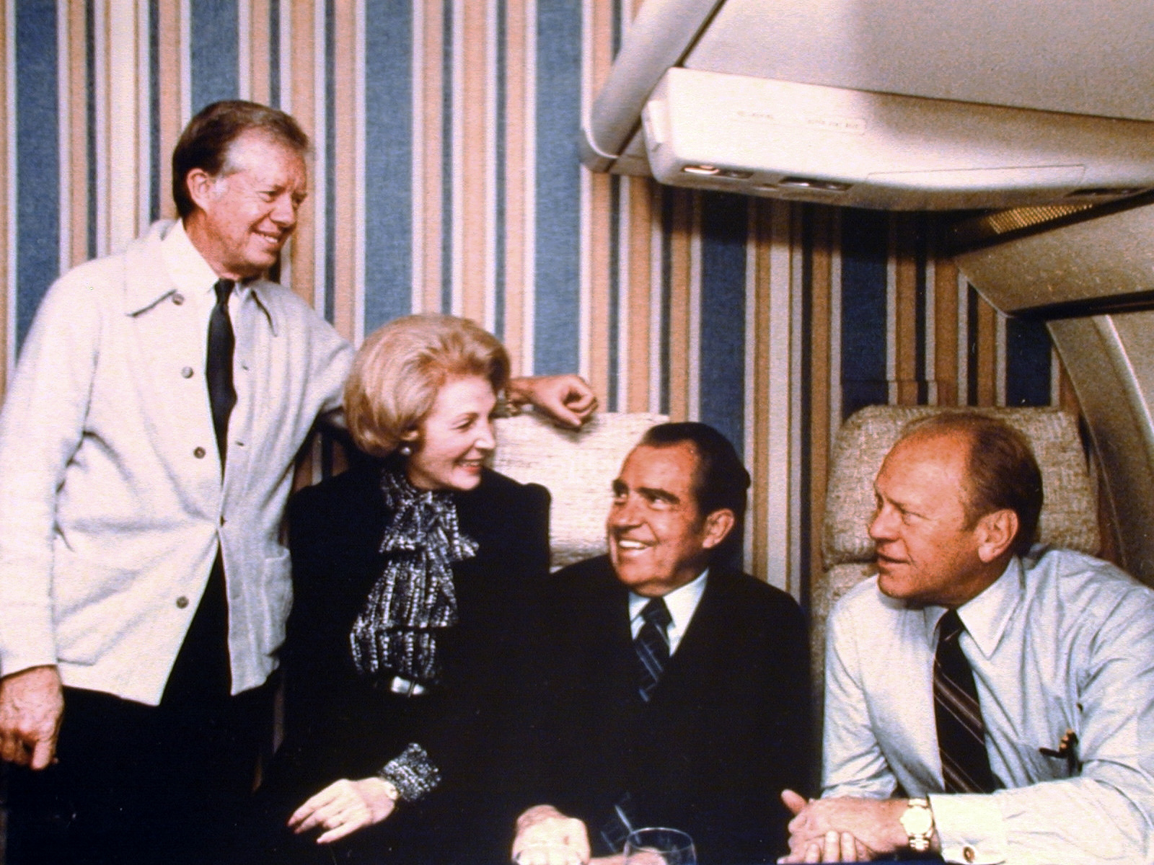
20世纪第二阶段
收缩期

Slide 40
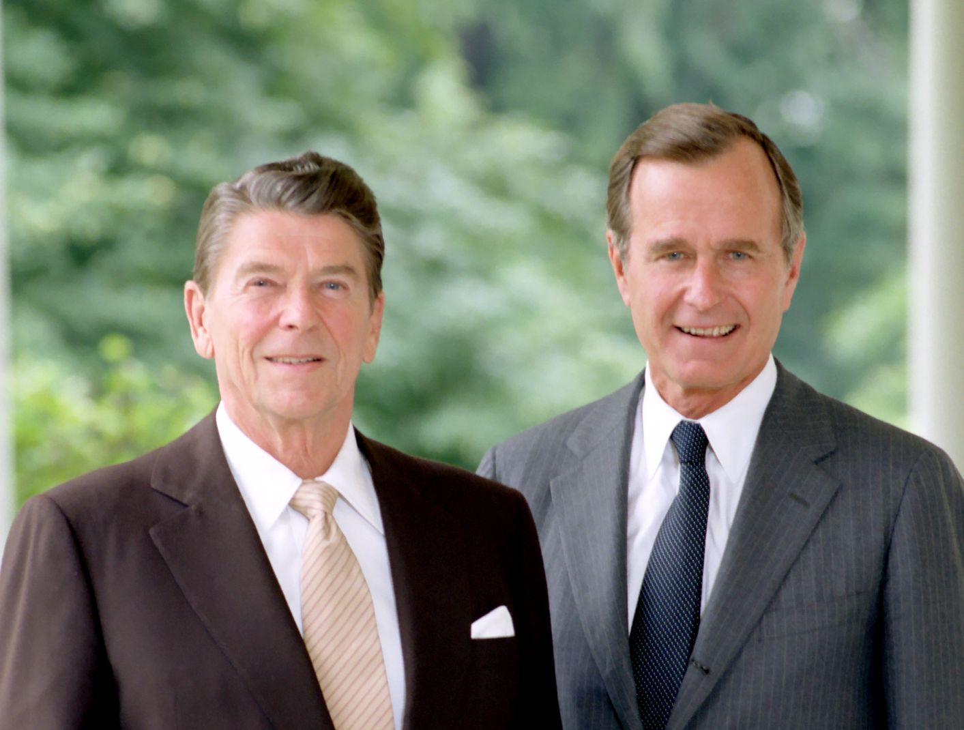
20世纪第三阶段
扩张期

Slide 41
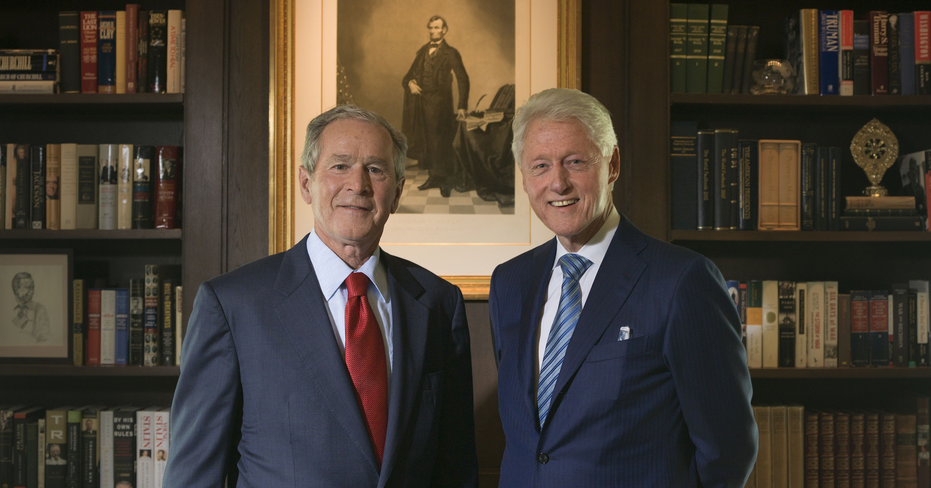
20-21世纪第三阶段
扩张期

Slide 42
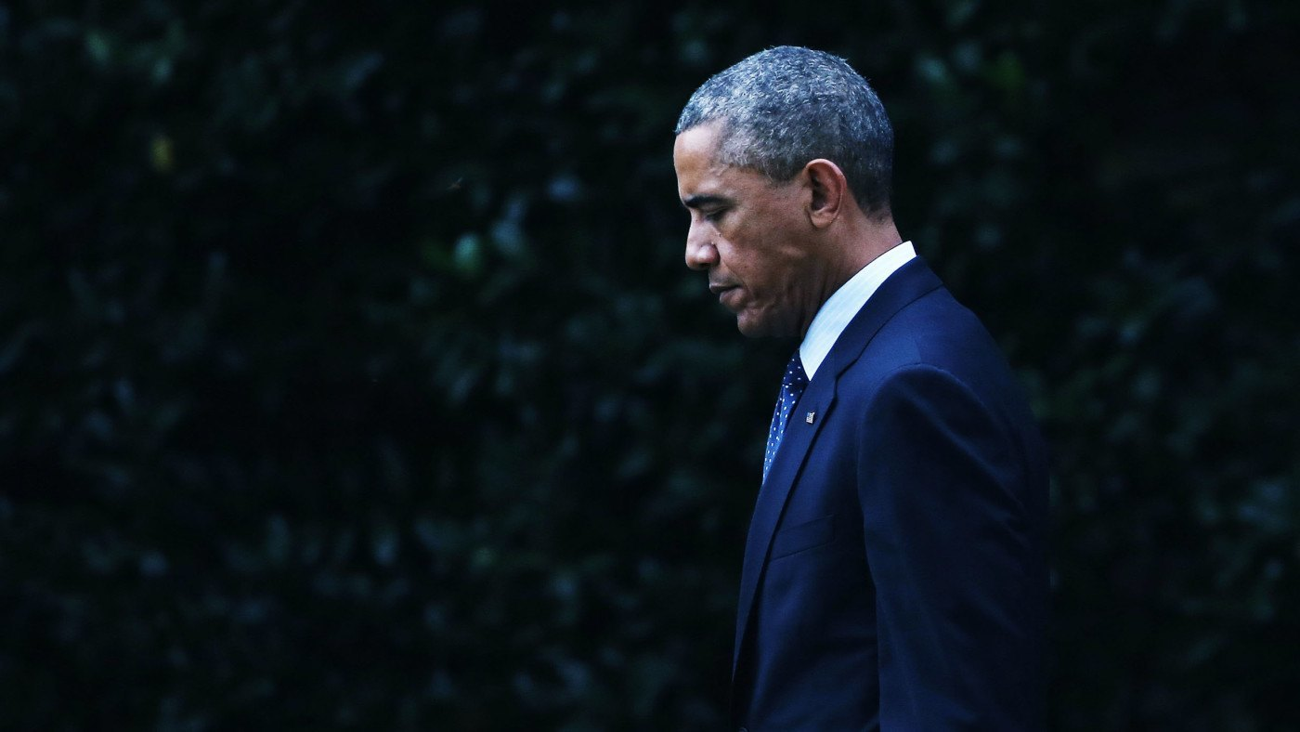
20-21世纪第三阶段
收缩期

